Slide 1
NUMERICAL INTEGRATION

Slide 2
Introduction to Numerical Integration
Definitions
Trapezoid Method
Examples

Slide 3
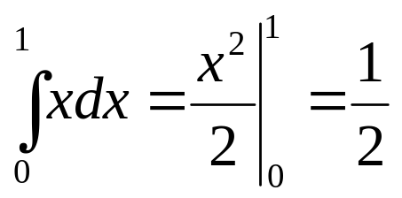
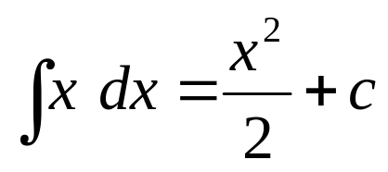
Integration
Indefinite Integrals
Indefinite Integrals of a function are functions that differ from each other by a constant.
Definite Integrals
Definite Integrals are numbers.

Slide 4
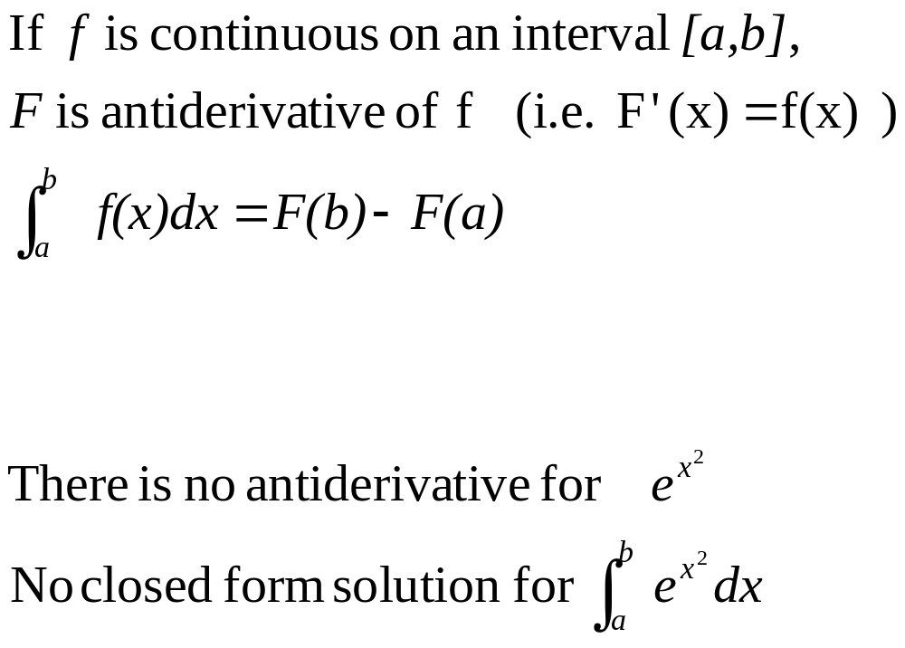
Fundamental Theorem of Calculus

Slide 5
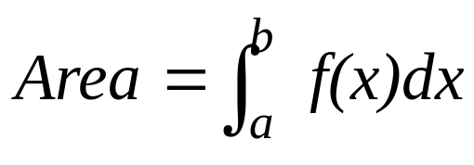
THE AREA UNDER THE CURVE
One interpretation of the definite integral is
Integral = area under the curve
f(x)
a
b

Slide 6
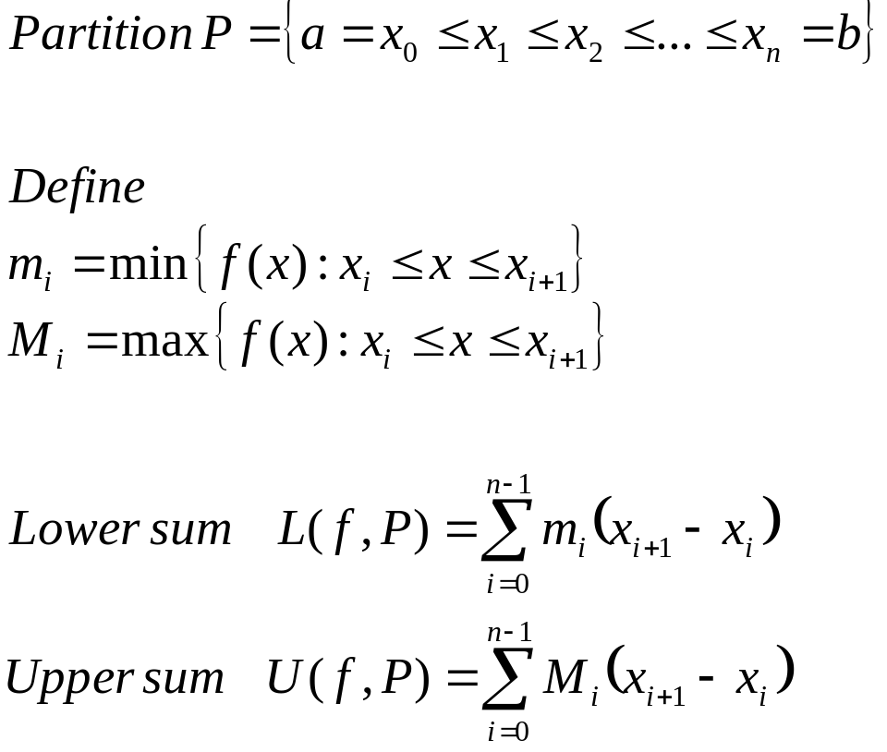
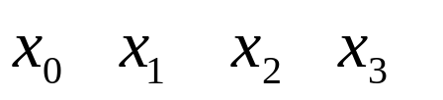
Upper and Lower Sums
The interval is divided into subintervals
f(x)
a
b

Slide 7
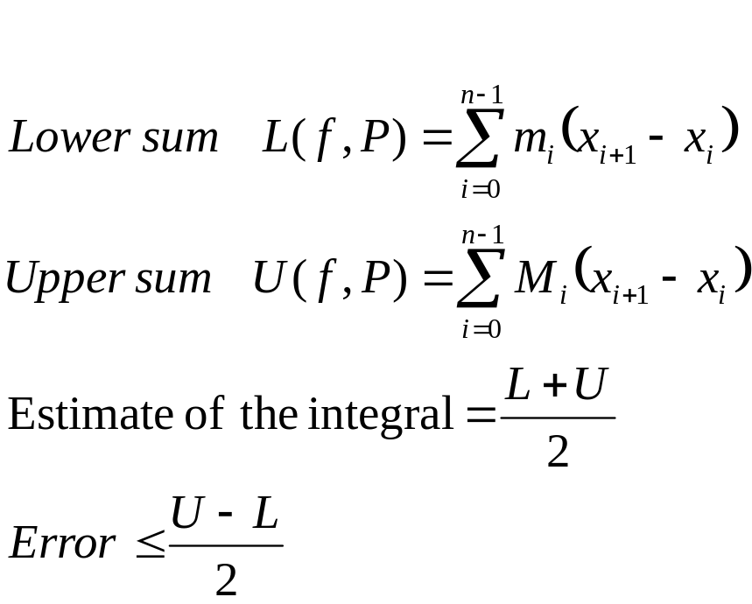
Upper and Lower Sums
f(x)
a
b

Slide 8
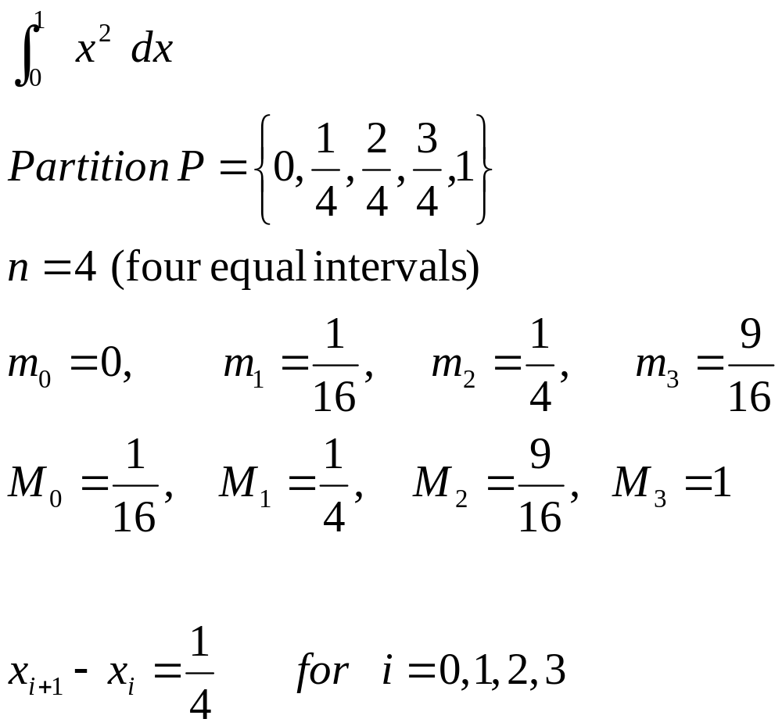
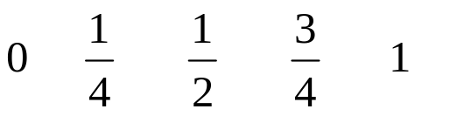
Example

Slide 9
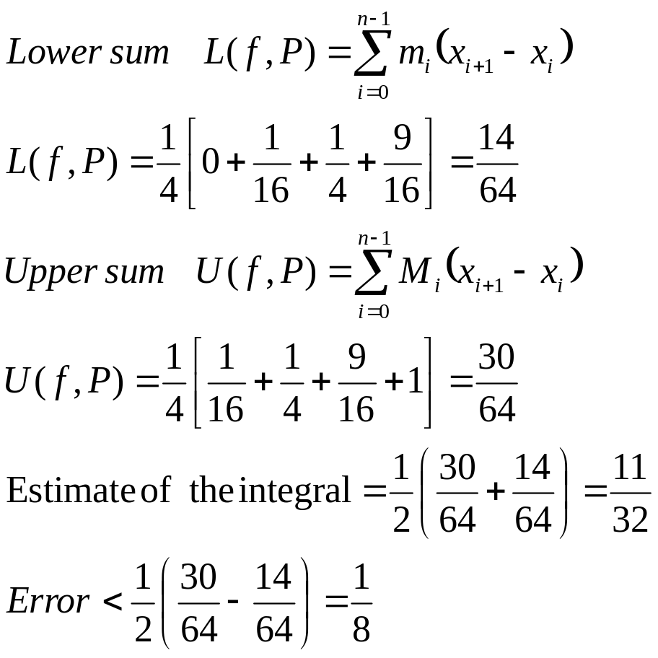
Example

Slide 10
Upper and Lower Sums
Estimates based on Upper and Lower Sums are easy to obtain for monotonic functions (always increasing or always decreasing).
For non-monotonic functions, finding maximum and minimum of the function can be difficult and other methods can be more attractive.

Slide 11
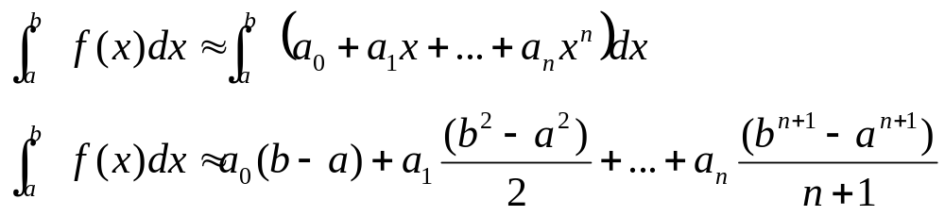
NEWTON-COTES METHODS
In Newton-Cote Methods, the function is approximated by a polynomial of order n
Computing the integral of a polynomial is easy.

Slide 12
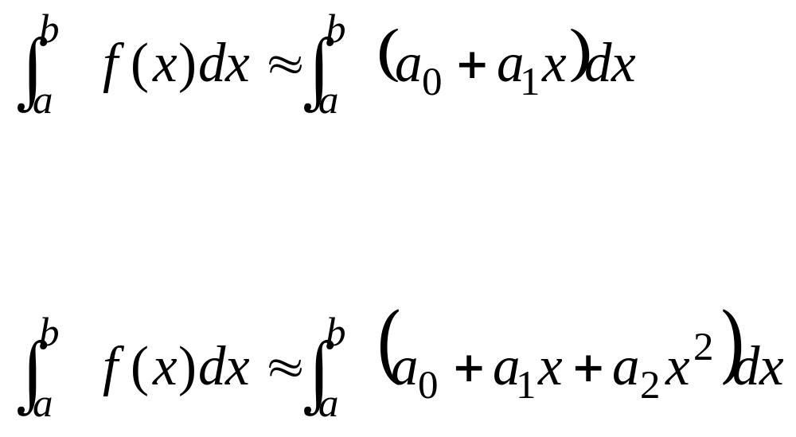
Newton-Cotes Methods
  Trapezoid Method (First Order Polynomial are used)
  Simpson 1/3 Rule (Second Order Polynomial are used),

Slide 13
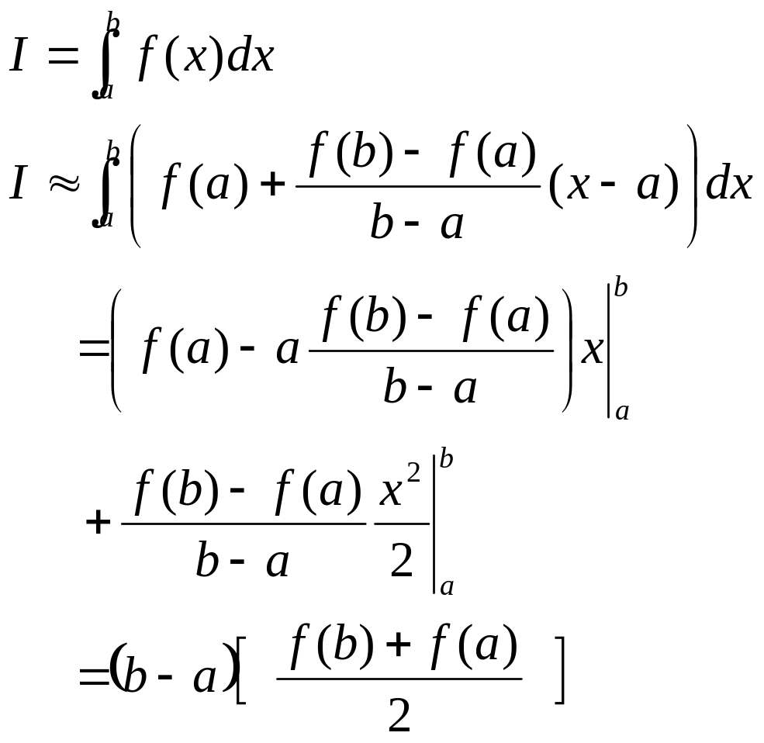
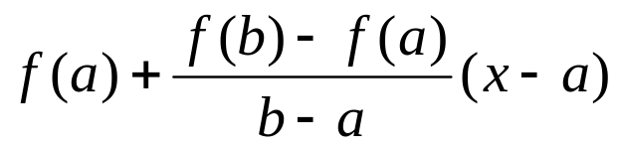

Trapezoid Method
f(x)

Slide 14
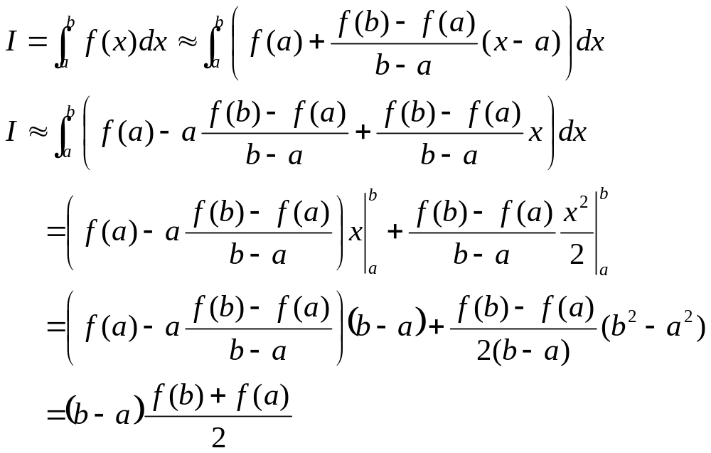
Trapezoid Method
Derivation-One interval

Slide 15


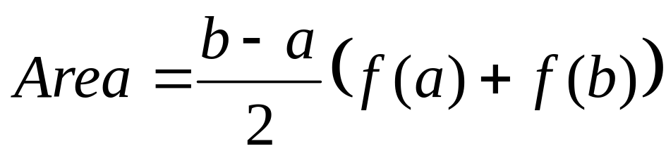
Trapezoid Method
f(x)

Slide 16
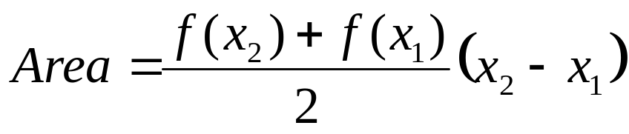
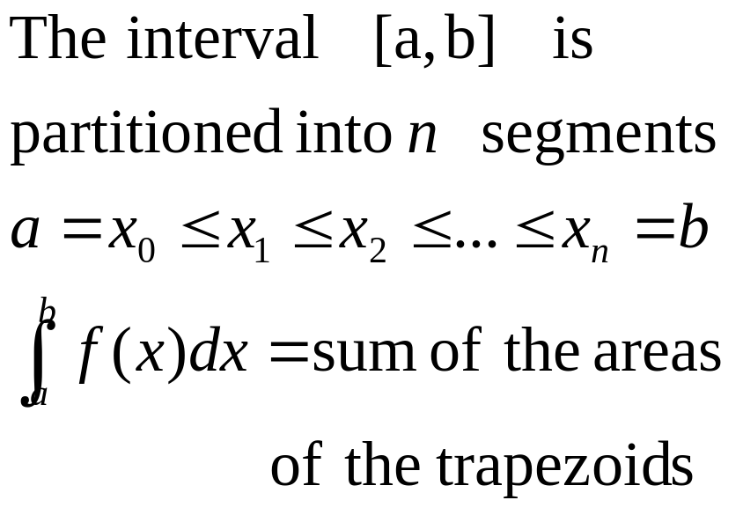
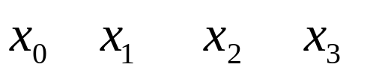
TRAPEZOID METHOD
Multiple Application Rule
f(x)
x
a
b

Slide 17
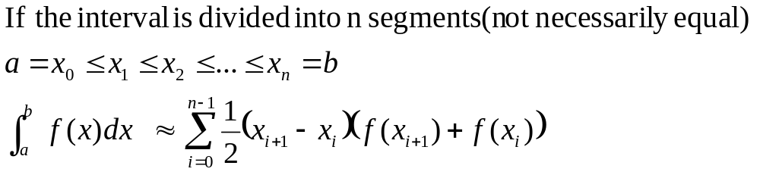
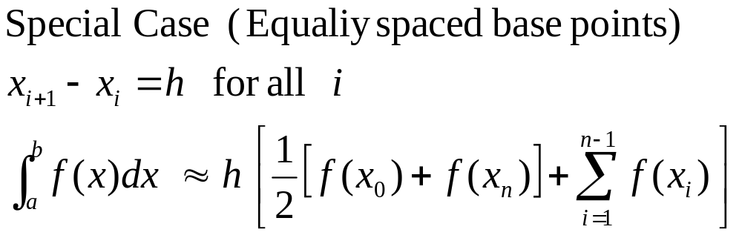
TRAPEZOID METHOD
General Formula and special case

Slide 18
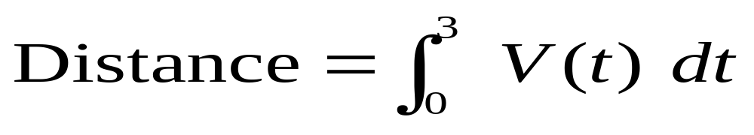
Example
Given a tabulated values of the velocity of an object.
Obtain an estimate of the distance traveled in the interval [0,3].
Time (s) | 0.0 | 1.0 | 2.0 | 3.0
Velocity (m/s) | 0.0 | 10 | 12 | 14
Distance = integral of the velocity

Slide 19
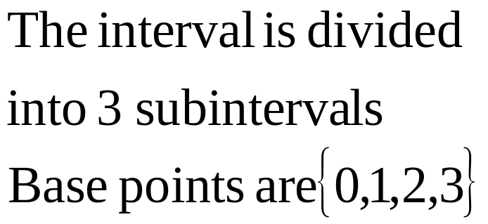
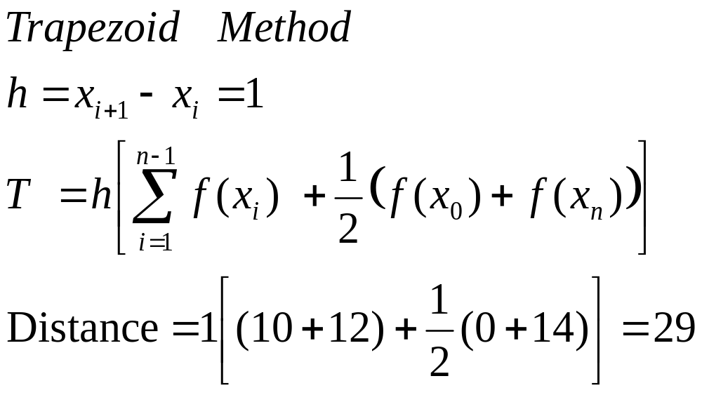
Example 1
Time (s) | 0.0 | 1.0 | 2.0 | 3.0
Velocity (m/s) | 0.0 | 10 | 12 | 14

Slide 20
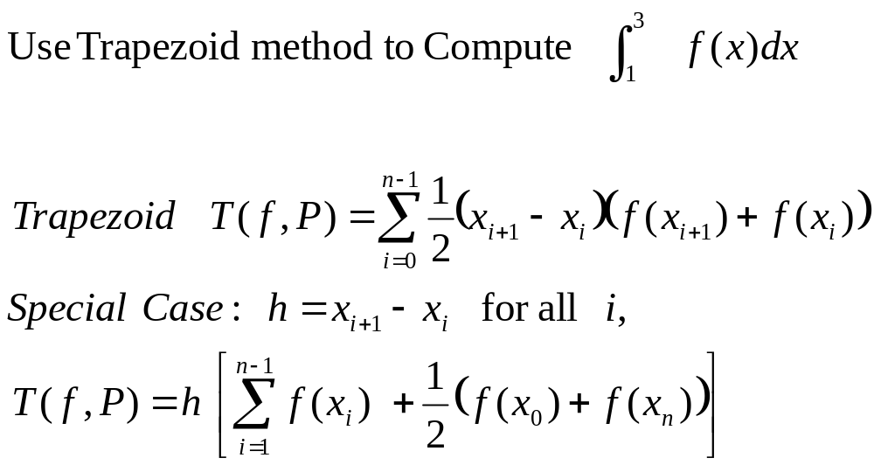
Example
x | 1.0 | 1.5 | 2.0 | 2.5 | 3.0
f(x) | 2.1 | 3.2 | 3.4 | 2.8 | 2.7

Slide 21
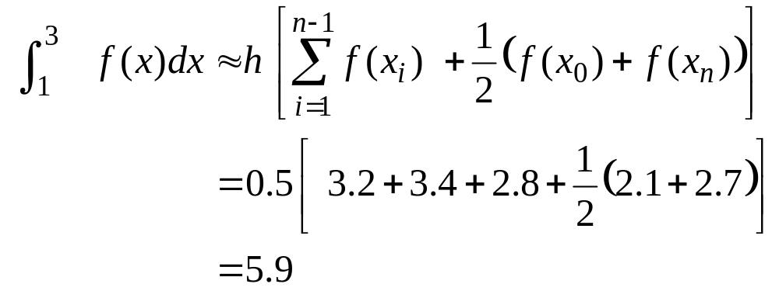
Example
x | 1.0 | 1.5 | 2.0 | 2.5 | 3.0
f(x) | 2.1 | 3.2 | 3.4 | 2.8 | 2.7

Slide 22
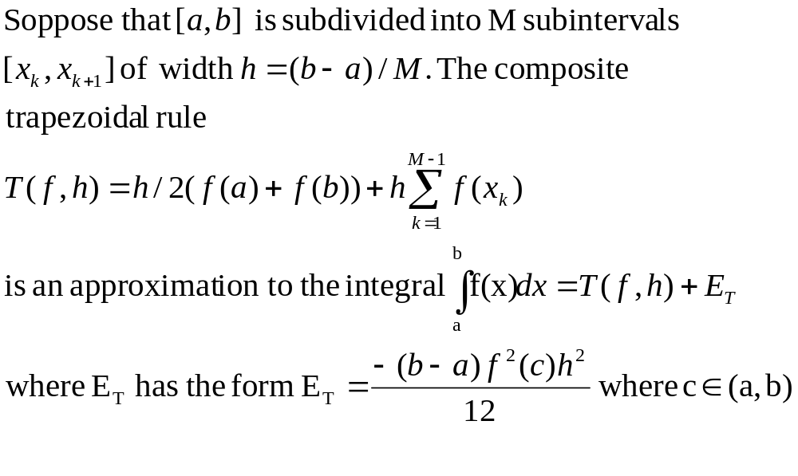
TRAPEZOIDAL RULE ERROR ANALYSIS

Slide 23
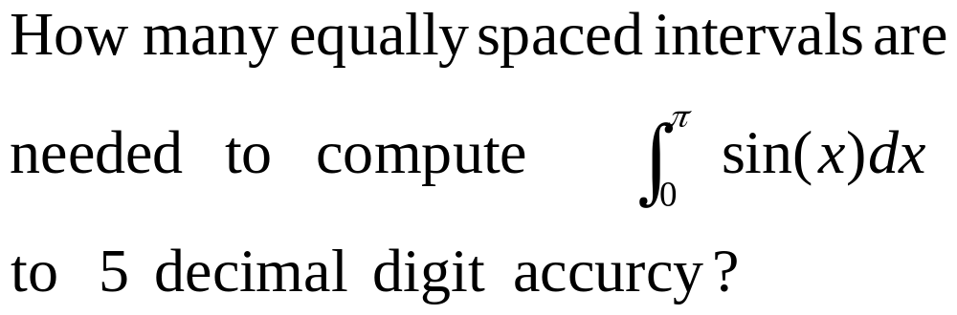
ESTIMATING THE ERROR
For Trapezoid method

Slide 24
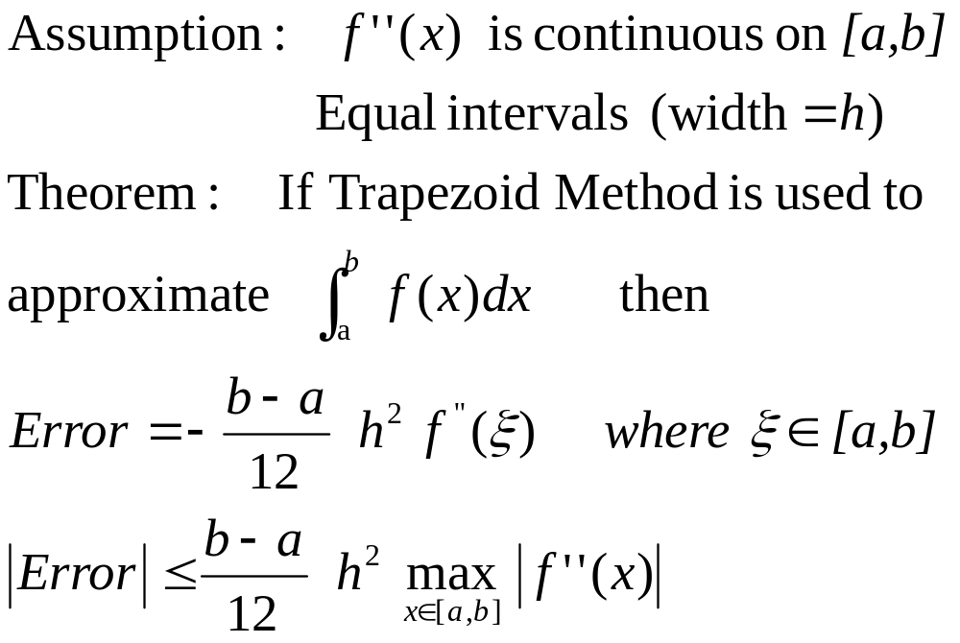
Error in estimating the integral
Theorem

Slide 25
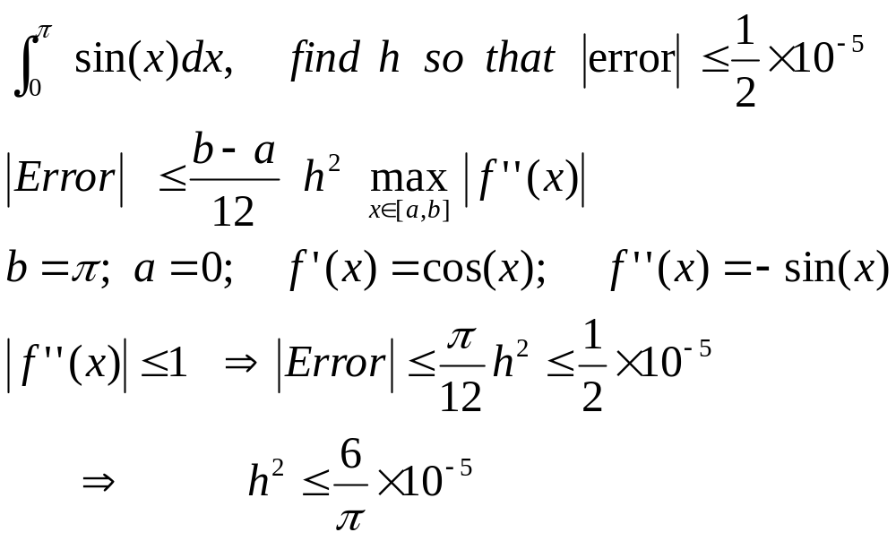
Example

